Slide 1
Lecture 5:
Decision Support Systems
Dr. Taysir Hassan Abdel Hamid

Slide 2
Management Information and Decision Support Systems
How these information technologies have significantly strengthened the role information systems play in supporting the decision-making activities of managerial end users

Slide 3
The Differing Focuses of Major Types of Information Systems
Type of Information System Focus
Expert systems Knowledge-from Experts
Decision systems Decisions-interactive support
Executive information systems Information-for executives
Management information Information-for managerial systems end users
Transaction processing Data-from business
System operations

Slide 4
Management Information and Decision Support Systems
Information Characteristics
Strategic
Management
Ad-Hoc
Unscheduled
Summarized
Infrequent
Forward looking
External
Wide Scope
Tactical
Management
Operational
Management

Slide 5
Management Information and Decision Support Systems
Information Characteristics
Strategic
Management
Prespecified
Scheduled
Detailed
Frequent
Historical
Internal
Narrow focus
Tactical
Management
Operational
Management

Slide 6
Management Information and Decision Support Systems
Strategic
Management
Tactical
Management
Operational
Management
The type of information required by managers is related to The level management and the amount of structure in the decision they place

Slide 7
Management Information and Decision Support Systems
Unstructured Decision
Strategic
Management
Tactical
Management
Semistructured Decision
Operational
Management
Structured Decision
The type of information required by managers is related to The level management and the amount of structure in the decision they place

Slide 8
Each level requires information products to meet the decision needs of managers.
Strategic Management level More summarized,ad hoc , Unscheduled forecasts,and external intelligence to support its Unstructured planning
Definition : Unstructured decision involve decision Situations where it is not possible to specify in advance most of the decision procedures to follow.

Slide 9
Strategic Management
Many decision situations are semistructured, that is:
some decision procedures can be prespecified ,but not enough to lead a definite decision.

Slide 10
Operational management
Require more prespecified , frequently scheduled , and detailed information with more narrow, internal ,and historical focus to support its structured decision
Definition:Structured decisions involve situations where the procedures to follow when a decision is needed can be specified in advance.

Slide 11
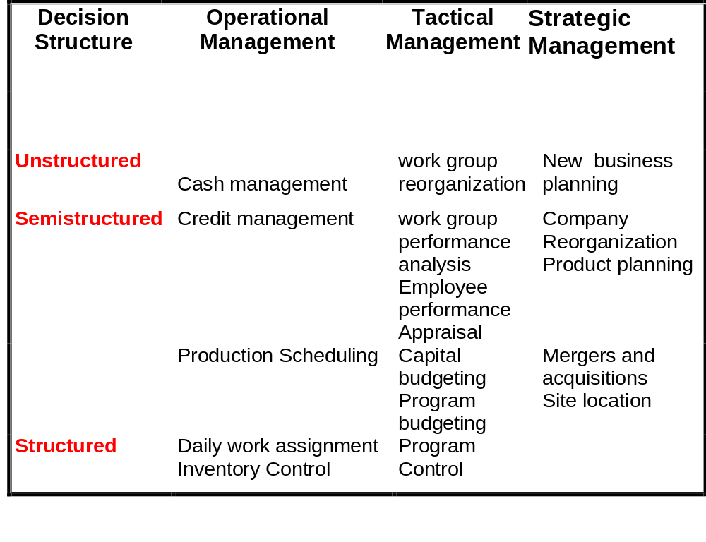
Examples

Slide 12
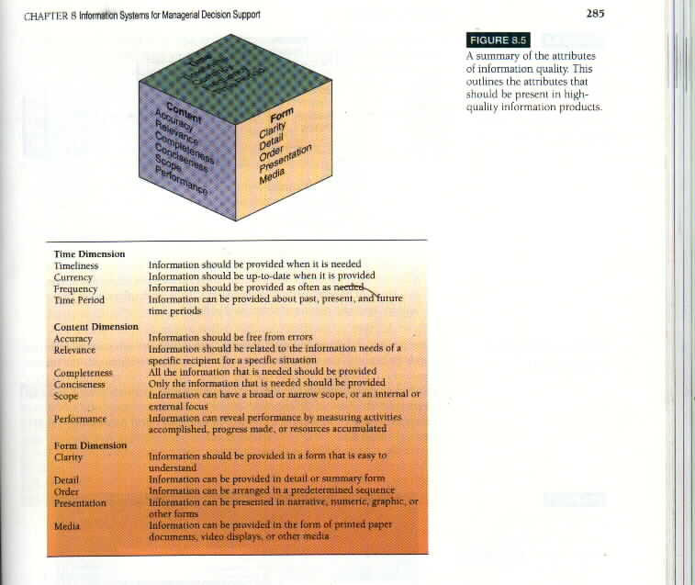
Information Quality

Slide 13
Information Quality
Time
Timeliness
Currency
Frequency
Time Period
Content
Accuracy
Relevancy
Completeness
Conciseness
Performance
Scope
Form
Clarity
Detail
Order
Presentation
Media

Slide 14
Information quality
What characteristics make information meaningful and useful to manager?
Time Dimension
Timeliness
Information should be provided when it is needed
Currency
Information should be up-to-date when it is needed
Frequency
Information should be provided as often as needed
Time period
Information should be provided about past,present,and future time periods

Slide 15
Content dimension
Accuracy
Information should be Free from errors
Relevance
Information should be related to the information
Completeness
All Information that is needed should be provided
Conciseness
Only Information that is needed should be provided
Information can have a broad or narrow scope ,or an internal focus
Scope
Information can reveal Performance by activities measuring or resources accumulated
Performance

Slide 16
Form dimension
Information should be provided in a form that is easy to understand
Clarity
Detail
Information can be provided in detail or summery form
Order
Information can be arranged in a predetermined sequence
Presentation
Can be presented ,numeric ,graphic ,----,
Media
Can be presented in the form printed paper ,---

Slide 17
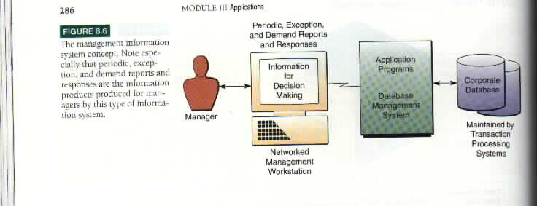
The Management Information System Concept

Slide 18
The Three major reporting alternatives
provided by MIS
-Periodic Scheduled Reports
Example :weakly sales analysis reports monthly financial statements
2-Exception Reports
Produced only when exceptional conditions occur or produced periodically but contain information about exceptional conditions
Example:Credit manager Can be provided with a report contains only information on customers who exceed there credit limits

Slide 19
The Three major reporting alternatives
provided by MIS
3)Demand Reports and Responses
Provided whenever a manager demands it
Example: DBMS allow managers at online workstations to get immediate responses on reports as a result of their requests for information.

Slide 20
Online Analytical processing(OLAP)
Definition: is a capability of:
management ,
decision support, and
executive information systems that enables managers to examine large amount of data from many perspectives

Slide 21
Online Analytical processing(OLAP)
It involves analyzing complex relationships among millions of data items stored in multidimensional databases to discover exception conditions
It provide fast answers to complex queries posed by managers using:
management ,
decision support, and
executive information systems

Slide 22
Online Analytical processing(OLAP)
Middle OLAP server
Front -End
Back-End
Warehouses database
Spreadsheets.
Statistical packages.
Graphical interfaces.
Executive IS.
Decision support IS.
Data is retrieved from back-end databases and staged in multidimensional database for OLAP
Relational
Network
Hierarchical

Slide 23
Online Analytical processing(OLAP)
Online Analytical Processing Involves the following basic analytical operations:
Consolidation:
Involves the aggregation of data. Sales offices can be rolled up to districts and districts rolled up to regions

Slide 24
Online Analytical processing(OLAP)
Drill-Down:OLAP can go in the reverse direction and automatically display detail data that comprises consolidated data
Slicing and Dicing:look at the database form different view points one slice of sales database might show all sales of product type within regions.
Slicing and dicing is often performed along a time axis in order to analyze trends and fined patterns

Slide 25
Summary OLAP applications
Access large amount of data(several years of sales)
Analyze the relationships between many types of business elements (sales, products, and regions)
Involve aggregated data (sales volume ,budget in dollars, dollars spent,region)

Slide 26
Summary OLAP applications
Compare aggregated data(monthly,quarterly,yearly)
Present data in different perspectives such as sales/region -sales/channels
Involve complex calculation between data elements profits as a function of sales for each type of sales channel within each region

Slide 27
Decision Support Systems(DSS)
Provide information support for the managers during the decision-making process

Slide 28
Decision Support Systems(DSS)
DSS use:
1- Analytical models
2- Specialized databases
3-A decision maker ’s own insights and judgments
4- An interactive computer-based modeling process to support the making of semi-structured and unstructured decisions by individual managers
They are designed to be ad hoc quick response systems

Slide 29
MIS provides managers with reports based on routine flows of data and assists the general control of the organization
DSS,however,focus on providing information to support specific types of decisions by individual managers.
Managers at the tactical and strategic level of an organization need ad hoc types of information products to support there planning.
A DSS designed to support semistructured and unstructured problem analysis

Slide 30
Types Of DSS
There are two basic types of DSS:
1-Model driven
2-Data driven

Slide 31
Types Of DSS
Model -driven DSS
-A standalone systems isolated from major organizational information systems that used some types of models to perform some kinds of analyses.
-Their analysis capabilities are based on strong theory or model combined with a good user interface that made the model easy to use

Slide 32
Types Of DSS
Data-driven DSS
-This system analyze large pools of data found in major organizational systems.
-Data from transaction processing system are collected in warehouses for this purpose
-On-line analytical processing (OLAP) and Data mining can then be used to analyze the data

Slide 33
Example of a Decision-Support System
Large Egyptian metals company carry bulk cargoes of coal, oil
The firm owns some vessels, charters others and bids for shipping contracts in the open market to carry general cargo

Slide 34
Financial calculations
Ship/time costs
Port expenses
Technical details
Ship cargo capacity
Speed
Port distances
Fuel and water consumption
Location of cargo for different ports

Slide 35
The DSS system can answer questions such as:
Which vessel should be assigned at what rate to maximize profits?
What is the optimum speed at which particular vessel can optimize its profits and still meet its delivery schedule ?
What is the optimal loading pattern for a ship for the Egyptian port from Malaysia?

Slide 36
Ship File
Speed,capacity,---
Port distance
restrictions
PC
Fuel
consumption
cost file
Graphics
Analytical
Model
Database
Ship charter
cost File
Reports
Port expense
File

Slide 37
Types Of DSS
Data-driven DSS
This system Analyze large pools of data found in major organizational systems.
Data from transaction processing system are collected in warehouses for this purpose
On-Line Analytical Processing (OLAP) and Data mining can then be used to analyze the data

Slide 38
Data mining
Datamining provides insights into corporate data that cannot be obtained with OLAP by finding hidden patterns and relationships in large databases and inferring rules from them to predict future behavior.

Slide 39
Example of DSS Applications
Institutional DSS : if it is developed to solve a complex problems that continually face an organization
Ad hoc DSS : if it is developed quickly to solve smaller problems that may be one-time situations facing a manager.
Examples: Airline DSS
Real Estate DSS
Geographic DSS

Slide 40
Comparison between DSS and MIS
Management Decision Support
Information Systems Systems
Information Provided
(Information form Periodic ,exception, Interactive inquiries
and frequency) ,demand reports, and responses
and responses

Slide 41
Comparison between DSS and MIS
Management Decision Support
Information Provided Information Systems Systems
Information format Prespecified and Ad hoc,flexible,and
fixed format adaptable format

Slide 42
Comparison between DSS and MIS
Management Decision Support
Information Provided Information Systems Systems
Information Information produced Information produced processing by extraction and by analytical modeling methodology manipulation of of operational and o operational data external data

Slide 43
Comparison between DSS and MIS
Decision Support Management Decision Support
provided Information Systems Systems
Type Of Support Provide information Provide information
about the performance and decision support
of the organization techniques to confront
specified problems or
opportunities

Slide 44
Comparison between DSS and MIS
Decision Support Management Decision Support
Provided Information Systems Systems
Stages of decision Support the intelligence Support the intelligence
making supported and implementation design,choice,and
stages of decision implementation stages
making of decision making

Slide 45
Comparison between DSS and MIS
Decision support Management Decision Support
Provided Information Systems Systems
Types of decision Structured decisions Semistructured and
supported for operational and unstructured decision
tactical planning and for tactical and
control Strategic planning and
control

Slide 46
Comparison between DSS and MIS
Decision Support Management Decision Support
Provided Information Systems Systems
Type of decision Indirect support designed Direct support
maker supported for many managers tailored to the
decision-making
styles of individual
managers

Slide 47
Component of a DSS
Hardware and Network resources
Software Resources
DSS Software packages (DSS Generators) contain Software modules to manage DSS database , decision models, and end user / system dialogue.
Data resources - data and information extracted from the organization database, external database ,and managers personal database.

Slide 48
Component of a DSS
Model resources : Mathematical model and analytical techniques stored as programs ,subroutines , spreadsheets, and command files.
People resources -Managers , end users , information system specialists

Slide 49
Models for Decision Support System
IT depends on model bases as well as databases as vital system resources
Model base is an organized collection of mathematical models:
To support specific decisions
To support general –purpose decisions

Slide 50
Models for Decision Support System
Simple Computational models:
Example: Simple accounting relationships among variables
Revenue - Expenses =Profit

Slide 51
Models for Decision Support System
Complex models: Complex relationships between variables in this case analytical techniques uses:
Linear programming models
Multiple regression forecasting models
Capital budgeting present value models
Such models may be stored in the form of spreadsheet models,programs modules, and command files

Slide 52
Models for Decision Support System
Model base management software packages can combine models to create integrated models that support specific type of decisions.

Slide 53
Analytical Modeling Alternatives
There are four basic types of analytical modeling alternatives :
1- What-if -analysis
2- Sensitivity analysis
3- Goal-seeking analysis
4- Optimization analysis

Slide 54
What-if -analysis
Making changes to variables or relationships among variables ,
Observes the resulting changes in the values of other variables
Example:Using a spreadsheet ,you may change:

Slide 55
What-if -analysis
Example:Using a spreadsheet ,you may change:
Revenue amount
[Variable],or
[Relationship among variables]
Tax rate formula
And then you can command the spreadsheet program to recalculate all effected variables such as Net profit after taxes.

Slide 56
What-if -Analysis
Net profit is a key factor in making many types of decisions.
This types of analysis would be repeated until the manager was satisfied.

Slide 57
Sensitivity Analysis
It is really a case of What-if -Analysis involving repeated changes to only one variable at a time.
i.e One variable at a time.
Observation of the resulting changes on other variables

Slide 58
Sensitivity Analysis
Example:
The value of revenue could be changed in small increments, the effect on other variables observed
This would help a manager understand the impact of various revenue levels on other factors involved in the decisions being considered

Slide 59
Goal-seeking analysis
Example:
Goal=2 million $ for net profit,then:change revenue or expenses until a result of 2 million $ is achieved
The analysis answers the questions
How can we achieved 2 million $ ?
What happens if we change revenue an expenses ?

Slide 60
Optimization analysis
A complex extension of Goal- seeking analysis
Instead of setting a specific target value(goal) you must search for the optimum value for one or more target variable.

Slide 61
Optimization analysis
Example:
You could try to determine the highest possible level of profits that could be achieved by varying the values for selected revenue sources and expense categories

Slide 62
Group Decision support systems
An important dimension of managerial decision making is the decision making by groups of people.
Example:
A manager may ask advice from other people before making decision
The manager may bring a group of people together to discuss an issue.

Slide 63
Executive Information Systems
EIS combine many of the features of both MIS and DSS.This system developed to meet the strategic information needs of the top management.
i.e provide in easy way information about critical success factors of firms ( CSFs) [Key factors]
Example: The executives of store chain would consider factors such as its sales promotion efforts and its product line mix that is critical to its survival and success.
STORE SALES + PRODUCT

Slide 64
Rationale for EIS
Much of a top executive's information comes from non computer sources.
Top executive's get the information they need from: letter,memos, periodicals ,reports produced manually or by computer systems -telephone calls-social activities.
Thus EIS must develop in such a way to meet the information needs of top management that are not met by other forms of MIS.

Slide 65
Rationale for EIS
The EIS have spread very rapidly into the rank of middle management because of their feasibility, benefits and less-expensive microcomputer-based systems.
(25% of the world’s corporate executives use EIS,3% of the users are top executives)
Thus EIS are becoming so widely used by managers, analysts, and other knowledge workers that sometimes it is called “everyone’s information systems”

Slide 66
Thank You

